Slide 1
Week 1
Three Schema Architecture

Slide 2
Student Objectives
Upon completion of this video, you should be able to:
Distinguish between the description of the database and the database itself
Define database schema, database snapshot/state and instance
Name the 3 levels in the 3-Schema Architecture
Determine which levels will be affected by a change
Distinguish between Logical Data Independence and Physical Data Independence

Slide 3
Schemas, Instances and Database State
SChema
Instance
State/snapshot
A description of the database but NOT the data itself
Similar to types in programming languages
E.g. Our database might have 3 tables:
Patient (patient name, OHIP number)
Room (room number, num of beds)
Nurse (nurse name, nurse employee id)
An occurrence of a data item described in the schema
E.g. The Patient name might be “Homer Simpson” and the OHIP number might be “123-345-567”
The data in the database at a moment in time
Current set of instances
Every time we delete or add or change a value of a data item we change the state.

Slide 4
More info about Schemas and states
When we define a new database, we are specifying its schema
Initially the state/snapshop will be empty
Part of the DBMS’s job is to make sure every state is a valid state
The schema of the schema is called the meta data. The DBMS stores the schema for the schema of each database.
QUESTION: Changes occur frequently in the Database Schema or the Database State or Both?

Slide 5
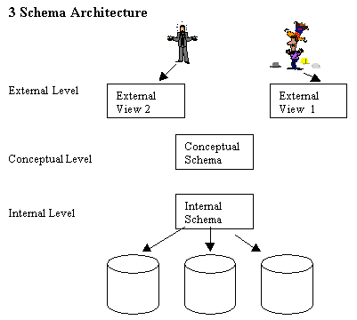
3-Schema Architecture
Each view only shows the data that each end user is interested in and hides the other data.
Normally the data in the database is stored in tables (the relational model).
Describes the data storage and indices to get to the data.

Slide 6
Data Independence
Logical Data Independence
Capacity to change the conceptual schema without affecting the external schema or views
Physical Data Independence
Ability to change the physical schema without changing the conceptual schema
The goal is to have BOTH physical and logical data independence!

